Slide 1
Dynamic Programming

Slide 2
1.Matrix Chain Multiplication
Matrix-chain multiplication problem
  Given a chain A₁, A₂, …, A_{n} of n matrices, where for i=1, 2, …, n, matrix A_{i} has dimension p_{i-1}×p_{i}
  Parenthesize the product A₁A₂…A_{n} such that the total number of scalar multiplications is minimized.

Slide 3
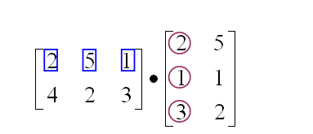
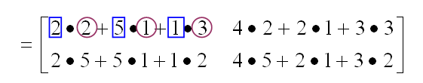
Matrix Multiplication
p×q
q×r
p×r
Cost: Number of scalar multiplications = pqr

Slide 4
Example
Matrix Dimensions
A₁ 13 x 5
A₂ 5 X 89
A₃ 89 X 3
A₄ 3 X 34

Slide 5
Parenthesization Scalar multiplications
1 ((A₁ A₂ ) A₃ ) A₄ 10,582
2 (A₁ A₂ ) (A₃ A₄ ) 54,201
3 (A₁ (A₂ A₃ )) A₄ 2, 856
4 A₁ ((A₂ A₃ ) A₄ ) 4, 055
5 A₁ (A₂ (A₃ A₄ )) 26,418
1. 13 x 5 x 89 scalar multiplications to get (A₁A₂) 13 x 89 result
13 x 89 x 3 scalar multiplications to get ((A₁A₂)A₃) 13 x 3 result
13 x 3 x 34 scalar multiplications to get (((A₁A₂)A₃) A₄) 13 x 34

Slide 6
Dynamic Programming Approach
The structure of an optimal solution
  Let us use the notation A_{i..j} for the matrix that results from the product A_{i} A_{i+1} … A_{j}
  An optimal parenthesization of the product A₁A₂…A_{n} splits the product between A_{k} and A_{k+1} for some integer k where1 ≤ k < n
  First compute matrices A_{1..k} and A_{k+1..n} ; then multiply them to get the final matrix A_{1..n}

Slide 7
Dynamic Programming Approach …contd
  Key observation: parenthesizations of the subchains A₁A₂…A_{k} and A_{k+1}A_{k+2}…A_{n} must also be optimal if the parenthesization of the chain A₁A₂…A_{n} is optimal.
  That is, the optimal solution to the problem contains within it the optimal solution to subproblems.

Slide 8
Dynamic Programming Approach …contd
Recursive definition of the value of an optimal solution.
  Let m[i, j] be the minimum number of scalar multiplications necessary to compute A_{i..j}
  Minimum cost to compute A_{1..n} is m[1, n]
  Suppose the optimal parenthesization of A_{i..j} splits the product between A_{k} and A_{k+1} for some integer k where i ≤ k < j

Slide 9
Dynamic Programming Approach …contd
  A_{i..j} = (A_{i} A_{i+1}…A_{k})·(A_{k+1}A_{k+2}…A_{j})= A_{i..k} · A_{k+1..j}
  Cost of computing A_{i..j} = cost of computing A_{i..k} + cost of computing A_{k+1..j} + cost of multiplying A_{i..k} and A_{k+1..j}
  Cost of multiplying A_{i..k} and A_{k+1..j} is p_{i-1}p_{k} p_{j}
  m[i, j ] = m[i, k] + m[k+1, j ] + p_{i-1}p_{k} p_{j} for i ≤ k < j
  m[i, i ] = 0 for i=1,2,…,n

Slide 10
Dynamic Programming Approach …contd
  But… optimal parenthesization occurs at one value of k among all possible i ≤ k < j
  Check all these and select the best one
0 if i=j
m[i, j ] =
min {m[i, k] + m[k+1, j ] + p_{i-1}p_{k} p_{j} } if i<j
i ≤ k< j

Slide 11
Dynamic Programming Approach …contd
To keep track of how to construct an optimal solution, we use a table s
s[i, j ] = value of k at which A_{i} A_{i+1} … A_{j} is split for optimal parenthesization.

Slide 12
Ex:-
[A₁]_{5×4} [A₂]_{4×6} [A₃]_{6×2} [A₄]_{2×7}
P₀=5, p₁=4, p₂=6, p₃=2, p₄=7
1
2
3
4
M₁₁=0 | M₂₂=0 | M₃₃=0 | M₄₄=0
1
M₁₂= K= | M₂₃= K= | M₃₄= K=
2
Sequence
Size
M₁₃= K= | M₂₄= K=
3
M₁₄= K=
4

Slide 13
Matrix Chain Multiplication Algorithm
  First computes costs for chains of length l=1
  Then for chains of length l=2,3, … and so on
  Computes the optimal cost bottom-up.

Slide 14
Input: Array p[0…n] containing matrix dimensions and n
Result: Minimum-cost table m and split table s
Algorithm Matrix_Chain_Mul(p[], n)
{
for i:= 1 to n do
m[i, i]:= 0 ;
for len:= 2 to n do // for lengths 2,3 and so on
{
for i:= 1 to ( n-len+1 ) do
{
j:= i+len-1;
m[i, j]:= ∞ ;
for k:=i to j-1 do
{
q:= m[i, k] + m[k+1, j] + p[i-1] p[k] p[j];
if q < m[i, j]
{
m[i, j]:= q;
s[i, j]:= k;
}
}
}
}
return m and s
}
Time complexity of above algorithm is O(n³)

Slide 15
Constructing Optimal Solution
Our algorithm computes the minimum-cost table m and the split table s
The optimal solution can be constructed from the split table s
  Each entry s[i, j ]=k shows where to split the product A_{i} A_{i+1} … A_{j} for the minimum cost.
11-<number>

Slide 16
Example
Copy the table of previous example and then construct optimal parenthesization.

Slide 17
Optimal Binary Search Tree(OBST)
A binary search tree T is a binary tree, either it is empty or each node in the tree contains an identifier and,
  All identifiers in the left subtree of T are less than the identifier in the root node T.
  All identifiers in the right subtree are greater than the identifier in the root node T.
  The left and right subtree of T are also binary search trees.

Slide 18
Ex:- (a1,a2,a3)=( do,if,stop )
Here n=3
The number of possible binary search trees= (1/n+1)2n_{cn}
= ¼(6c₃)
=5
stop
if
do

Slide 19
Algorithm search(x)
{
found:=false;
t:=tree;
while( (t≠0) and not found ) do
{
if( x=t->data ) then found:=true;
else if( x<t->data ) then t:=t->lchild;
else t:=t->rchild;
}
if( not found ) then return 0;
else return 1;
}

Slide 20
Optimal Binary Search Trees
Problem
  Given sequence of identifiers (a₁,a₂ …., a_{n)} with a₁<a₂ <··· < a_{n.}
  Let p(i) be the probability with which we search for a_{i}
  Let q(i) be the probability with which we search for an identifier x such that a_{i}< x <a_{i+1} .
  Want to build a binary search tree (BST)
  with minimum expected search cost.

Slide 21
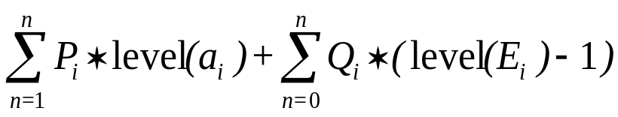
Identifiers : stop, if, do Internal node : successful search, p(i)
External node : unsuccessful search, q(i)
stop
if
E₃
do
E₂
E₀
E₁
The expected cost of a binary tree:
1 ≤ i ≤ n
0 ≤ i ≤ n
8 -<number>

Slide 22
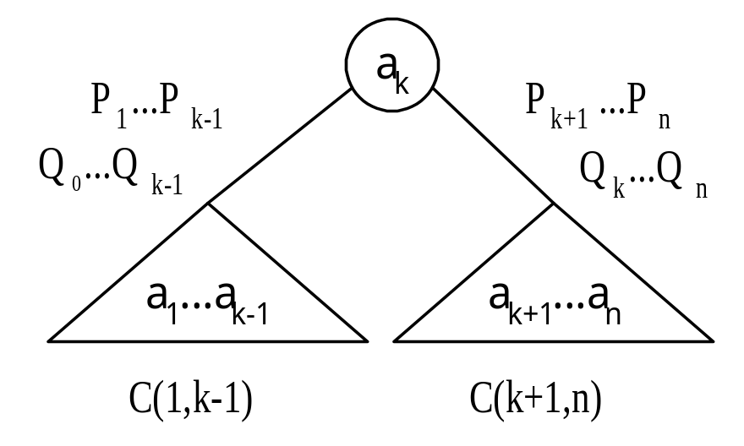
The dynamic programming approach
Make a decision as which of the a_{i}’s should be assigned to the root node of the tree.
If we choose a_{k}, then it is clear that the internal nodes for a_{1,}a₂,……,a_{k-1} as well as the external nodes for the classes E₀, E₁,….,E_{k-1} will lie in the left subtree l of the root. The remaining nodes will be in the right subtree r.

Slide 23
cost( l)= ∑ p(i)*level(a_{i}) + ∑ q(i)*(level(E_{i})-1)
cost(r)= ∑ p(i)*level(a_{i}) + ∑ q(i)*(level(E_{i})-1)
In both the cases the level is measured by considering the root of the respective subtree to be at level 1.
Using w(i, j) to represent the sum q(i) +∑ ( q(l)+p(l) ), we obtain the following as the expected cost of the above search tree.
p(k) + cost(l) + cost(r) + w(0,k-1) + w(k, n)
1≤i<k
0≤i<k
k< i ≤ n
k< i ≤ n
j
l=i+1

Slide 24
If we use c(i,j) to represent the cost of an optimal binary search tree t_{ij} containing a_{i+1},……,a_{j} and E_{i},…,E_{j}, then
cost(l)=c(0,k-1), and cost(r)=c(k,n).
For the tree to be optimal, we must choose k such that
p(k) + c(0,k-1) + c(k,n) + w(0,k-1) + w(k,n) is minimum.
Hence, for c(0,n) we obtain
c(0,n)= min c(0,k-1) + c(k, n) +p(k)+ w(0,k-1) + w(k,n)
We can generalize the above formula for any c(i,j) as shown below
c (i, j)= min c (i,k-1) + c (k,j) + p(k)+ w(i,k-1) + w(k,j)
1 ≤ k ≤ n
i< k ≤ j

Slide 25
c(i, j)= min cost(i,k-1) + cost(k,j) + w (i, j)
  Therefore, c(0,n) can be solved by first computing all c(i, j) such that j - i=1, next we compute all c(i,j) such that j - i=2, then all c(i, j) with j – i=3, and so on.
  During this computation we record the root r(i, j) of each tree t _{ij}, then an optimal binary search tree can be constructed from these r(i, j).
  r(i, j) is the value of k that minimizes the cost value.
Note:1. c(i,i) = 0, w(i, i) = q(i), and r(i, i) = 0 for all 0 ≤ i ≤ n
2. w(i, j) = p(j) + q(j) + w(i, j-1 )
i<k≤j

Slide 26
Ex 1: Let n=4, and ( a1,a2,a3,a4 ) = (do, if, int, while).
Let p(1 : 4 ) = ( 3, 3, 1, 1) and q(0: 4) = ( 2, 3, 1,1,1 ).
p’s and q’s have been multiplied by 16 for convenience.
Then, we get

Slide 27
w₀₀=2 c₀₀=0 r₀₀=0 | w₁₁=3 c₁₁=0 r₁₁=0 | w₂₂=1 c₂₂=0 r₂₂=0 | w₃₃=1 c₃₃=0 r₃₃=0 | w₄₄=1 c₄₄=0 r₄₄=0
0
1
w₀₁=8 c₀₁=8 r₀₁=1 | w₁₂=7 c₁₂=7 r₁₂=2 | w₂₃=3 c₂₃=3 r₂₃=3 | w₃₄=3 c₃₄=3 r₃₄=4
j-i
2
w₀₂=12 c₀₂=19 r₀₂=1 | w₁₃=9 c₁₃=12 r₁₃=2 | w₂₄=5 c₂₄=8 r₂₄=3
3
w₀₃=14 c₀₃=25 r₀₃=2 | w₁₄=11 c₁₄=19 r₁₄=2
4
w₀₄=16 c₀₄=32 r₀₄=2
Computation of c(0,4), w(0,4), and r(0,4)

Slide 28
From the table we can see that c(0,4)=32 is the minimum cost of a binary search tree for ( a1, a2, a3, a4 ).
The root of tree t₀₄ is a_{2.}
The left subtree is t₀₁ and the right subtree t₂₄.
Tree t₀₁ has root a₁; its left subtree is t₀₀ and right subtree t₁₁.
Tree t₂₄ has root a₃; its left subtree is t₂₂ and right subtree t₃₄.
Thus we can construct OBST.
if
do
int
while

Slide 29
Ex 2: Let n=4, and ( a1,a2,a3,a4 ) = (count, float, int,while).
Let p(1 : 4 ) =( 1/20, 1/5, 1/10, 1/20) and
q(0: 4) = ( 1/5,1/10, 1/5,1/20,1/20 ).
Using the r(i, j)’s construct an optimal binary search tree.

Slide 30
Time complexity of above procedure to evaluate the c’s and r’s
Above procedure requires to compute c(i, j) for
( j - i) = 1,2,…….,n .
When j – i = m, there are n-m+1 c( i, j )’s to compute.
The computation of each of these c( i, j )’s requires to find m quantities.
Hence, each such c(i, j) can be computed in time o(m).

Slide 31
The total time for all c(i,j)’s with j – i= m is
= m( n-m+1)
= mn-m²+m
=O(mn-m²)
Therefore, the total time to evaluate all the c(i, j)’s and r(i, j)’s is
∑ ( mn – m² ) = O(n³)
1 ≤ m ≤ n

Slide 32
We can reduce the time complexity by using the observation of D.E. Knuth
Observation:
    The optimal k can be found by limiting the search to the range r( i, j – 1) ≤ k ≤ r( i+1, j )
In this case the computing time is O(n²).

Slide 33
OBST Algorithm
Algorithm OBST(p,q,n)
{
for i:= 0 to n-1 do
{ // initialize.
w[ i, i ] :=q[ i ]; r[ i, i ] :=0; c[ i, i ]=0;
// Optimal trees with one node.
w[ i, i+1 ]:= p[ i+1 ] + q[ i+1 ] + q[ i ] ;
c[ i, i+1 ]:= p[ i+1 ] + q[ i+1 ] + q[ i ] ;
r[ i, i+1 ]:= i + 1;
}
w[n, n] :=q[ n ]; r[ n, n ] :=0; c[ n, n ]=0;

Slide 34
// Find optimal trees with m nodes.
for m:= 2 to n do
{
for i := 0 to n – m do
{
j:= i + m ;
w[ i, j ]:= p[ j ] + q[ j ] + w[ i, j -1 ];
// Solve using Knuth’s result
x := Find( c, r, i, j );
c[ i, j ] := w[ i, j ] + c[ i, x -1 ] + c[ x, j ];
r[ i, j ] :=x;
}
}

Slide 35
Algorithm Find( c, r, i, j )
{
for k := r[ i, j -1 ] to r[ i+1, j ] do
{ min :=∞;
if ( c[ i, k -1 ] +c[ k, j ] < min ) then
{
min := c[ i, k-1 ] + c[ k, j ]; y:= k;
}
}
return y;
}

Slide 36
Traveling Salesperson Problem (TSP)
Problem:-
You are given a set of n cities.
You are given the distances between the cities.
You start and terminate your tour at your home city.
You must visit each other city exactly once.
Your mission is to determine the shortest tour. OR
minimize the total distance traveled.

Slide 37
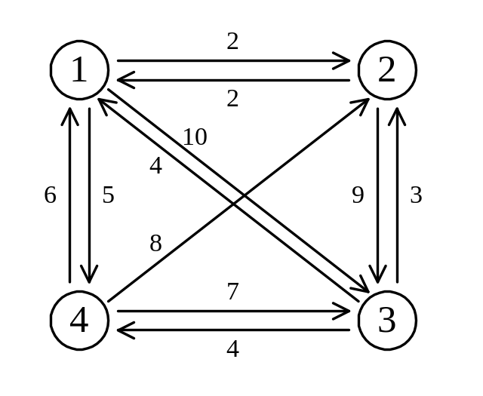
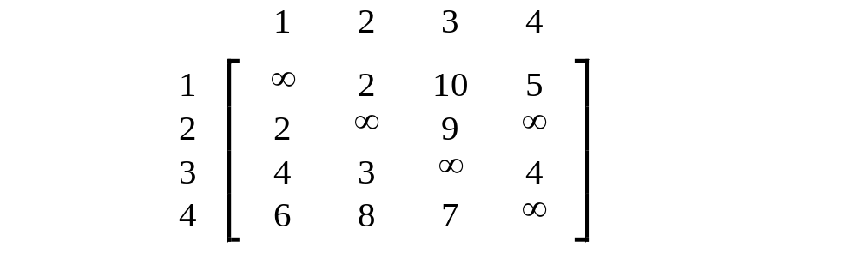
e.g. a directed graph :
Cost matrix:
0
0
0
0

Slide 38
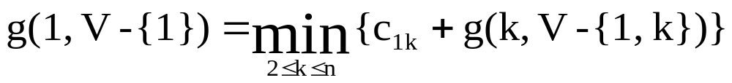
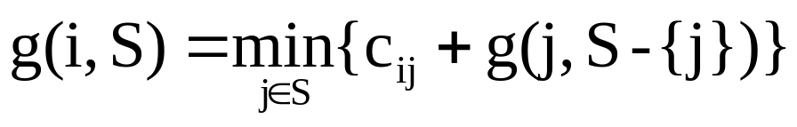
The dynamic programming approach
Let g( i, S ) be the length of a shortest path starting at vertex i, going through all vertices in S and terminating at vertex 1.
The length of an optimal tour :
The general form:
1
2

Slide 39
Equation 1 can be solved for g( 1, V- {1} ) if we know g( k, V- {1,k} ) for all choices of k.
The g values can be obtained by using equation 2 .
Clearly,
g( i, Ø ) = C_{i1} , 1≤ i ≤ n.
Hence we can use eq 2 to obtain g( i, S ) for all S of size 1. Then we can obtain g( i, s) for all S of size 2 and so on.

Slide 40
Thus,
g(2, Ø)=C₂₁=2 , g(3, Ø)=C₃₁=4
g(4, Ø)=C₄₁=6
We can obtain
g(2, {3})=C₂₃ + g(3, Ø)=9+4=13
g(2, {4})=C24 + g(4, Ø)=∞
g(3, {2})=C32 + g(2, Ø)=3+2=5
g(3, {4})=C34 + g(4, Ø)=4+6=10

Slide 41
g(4, {2})=C42 + g(2, Ø)=8+2=10
g(4, {3})=C43 + g(3, Ø)=7+4=11
Next, we compute g(i,S) with |S | =2,
g( 2,{3,4} )=min { c23+g(3,{4}), c24+g(4,{3}) }
=min {19, ∞}=19
g( 3,{2,4} )=min { c32+g(2,{4}), c34+g(4,{2}) }
=min {∞,14}=14
g(4,{2,3} )=min {c42+g(2,{3}), c43+g(3,{2}) }
=min {21,12}=12

Slide 42
Finally,
We obtain
g(1,{2,3,4})=min { c12+ g( 2,{3,4} ),
c13+ g( 3,{2,4} ),
c14+ g(4,{2,3} ) }
=min{ 2+19,10+14,5+12}
=min{21,24,17}
=17.

Slide 43
A tour can be constructed if we retain with each g( i, s ) the value of j that minimizes the tour distance.
Let J( i, s ) be this value, then J( 1, { 2, 3, 4 } ) = 4.
Thus the tour starts from 1 and goes to 4.
The remaining tour can be obtained from g( 4, { 2,3 } ). So J( 4, { 3, 2 } )=3
Thus the next edge is <4, 3>. The remaining tour is
g(3, { 2 } ). So J(3,{ 2 } )=2
The optimal tour is: (1, 4, 3, 2, 1)
Tour distance is 5+7+3+2 = 17

Slide 44
Floyd-Warshall Algorithm
All pairs shortest path problem

Slide 45
All-Pairs Shortest Path Problem
Let G=( V,E ) be a directed graph consisting of n vertices.
Weight is associated with each edge.
The problem is to find a shortest path between every pair of nodes.

Slide 46
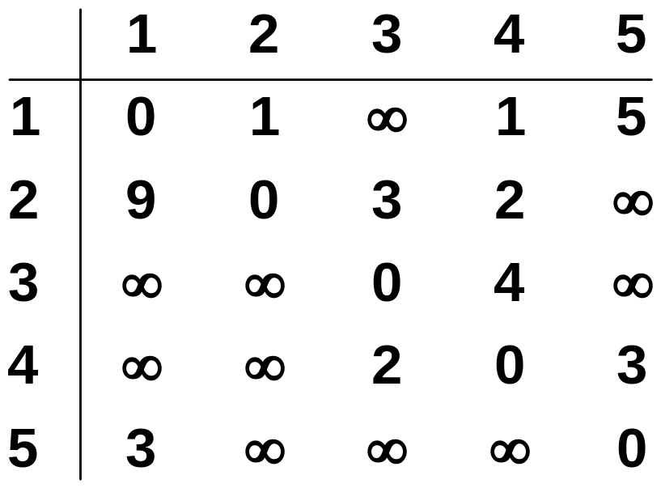
Ex:-
1
3
v₁
v₂
9
5
1
2
3
v₅
3
2
v₄
v₃
4

Slide 47
Idea of Floyd-Warshall Algorithm
Assume vertices are {1,2,……n}
Let d ^{k}( i, j ) be the length of a shortest path from i to j with intermediate vertices numbered not higher than k where 0 ≤ k ≤ n, then
d⁰( i, j )=c( i, j ) (no intermediate vertices at all)
d ^{k}( i, j )=min { d^{k-1}( i, j ), d^{k-1}( i, k )+ d^{k-1}( k, j ) }
d ^{n}( i, j ) is the length of a shortest path from i to j

Slide 48
In summary, we need to find d ^{n} with d ⁰ =cost matrix .
General formula
d ^{k} [ i, j ]= min { d ^{k-1}[ i, j ], d ^{k-1}[ i, k ]+ d ^{k-1}[ k, j ] }

Slide 49
Shortest path using intermediate vertices
{ V₁, . . . V_{k} }
d ^{k-1}[i, k]
V_{k}
d ^{k-1}[k, j]
V_{j}
V_{i}
d ^{k-1}[i, j]
Shortest Path using intermediate vertices
{ V_{1, . . .} V_{k -1} }

Slide 50
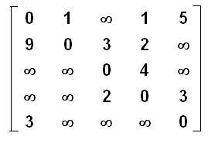
d⁰ =
d¹ =
d² =
d³ =
d⁴ =
d⁵ =

Slide 51
Algorithm
Algorithm AllPaths( c, d, n )
// c[1:n,1:n] cost matrix
// d[i,j] is the length of a shortest path from i to j
{
for i := 1 to n do
for j := 1 to n do
d [ i, j ] := c [ i, j ] ; // copy c into d
for k := 1 to n do
for i := 1 to n do
for j := 1 to n do
d [ i, j ] := min ( d [ i, j ] , d [ i, k ] + d [ k, j ] );
}
Time Complexity is O ( n ³ )

Slide 52


0/1 Knapsack Problem
Let x_{i} = 1 when item i is selected and let x_{i} = 0 when item i is not selected.
n
p_{i} x_{i}
maximize
i = 1
n
w_{i} x_{i} <= c
subject to
i = 1
and x_{i} = 0 or 1 for all i
All profits and weights are positive.

Slide 53

Sequence Of Decisions
Decide the x_{i} values in the order x₁, x₂, x₃, …, x_{n}.
OR
Decide the x_{i} values in the order x_{n}, x_{n-1}, x_{n-2}, …, x₁.

Slide 54
Problem State
Suppose that decisions are made in the order x₁, x₂, x₃, …, x_{n}.
The initial state of the problem is described by the pair (1, m).
  Items 1 through n are available
  The available knapsack capacity is m.
Following the first decision the state becomes one of the following:
  (2, m) … when the decision is to set x₁= 0.
  (2, m-w₁) … when the decision is to set x₁= 1.

Slide 55
Problem State
Suppose that decisions are made in the order x_{n}, x_{n-1}, x_{n-2}, …, x₁.
The initial state of the problem is described by the pair (n, m).
  Items 1 through n are available
  The available knapsack capacity is m.
Following the first decision the state becomes one of the following:
  (n-1, m) … when the decision is to set x_{n}= 0.
  (n-1, m-w_{n}) … when the decision is to set x_{n}= 1.

Slide 56
Dynamic programming approach
Let f_{n}(m) be the value of an optimal solution, then
f_{n}(m)= max { f_{n-1}(m), f_{n-1}( m-w_{n}) + p _{n} }
General formula
f_{i}(y)= max { f_{i-1}(y), f_{i-1}( y-w_{i}) + p _{i} }

Slide 57
We use set s^{i} is a pair ( P, W )
where P= f_{i}(y), W=y
Note That s⁰ =( 0, 0 )
We can compute s^{i+1} from s^{i} by first computing
s^{i} ={ ( P, W ) ( P- p_{i+1}, W- w_{i+1})€ s^{i} }
1

Slide 58
OR
S^{i} = S^{i} + (p_{i+1}, w_{i+1})
Merging :- s^{i+1} can be computed by merging the
pairs in s^{i} and s^{i}
Purging :- if s^{i+1} contains two pairs ( p _{j}, w _{j} ) and ( p _{k}, w _{k} )
with the property that p _{j} ≤ p _{k} and w _{j} ≥ w _{k} then the pair ( p _{j}, w _{j} ) can be discarded.
When generating s^{i}’s, we can also purge all pairs ( p, w ) with w > m as these pairs determine the value of f _{n} (x) only for x > m.
The optimal solution f _{n} (m) is given by the highest profit pair ( last pair in s^{n} ) .
1
1

Slide 59
Set of 0/1 values for the x _{i} ’ s
Set of 0/1 values for x _{i} ’ s can be determined by a search through the s^{i} s
  Let ( p, w ) be the highest profit tuple in s ^{n}
Step1: if ( p, w ) € s ^{n} and ( p, w ) € s ^{n -1}
x _{n} = 1
otherwise x _{n} = 0
This leaves us to determine how either ( p, w ) or
( p – p_{n}, w- w_{n} ) was obtained in S^{n-1} .
This can be done recursively ( Repeat Step1 ).

Slide 60
Ex: knapsack instance n=3, (w₁, w₂, w₃)=(2,3,4), (p₁,p₂,p₃)=(1,2,5), and m=6. for this data we have
S⁰ ={ (0,0) } ; s⁰ ={ (1,2) }
S¹ ={ (0,0), (1,2) } ; s¹={ (2,3), (3,5) }
S² ={ (0,0), (1,2), (2,3), (3,5) } ; s²={ ( 5,4), (6,6), (7,7), (8,9) }
S³ ={ (0,0), (1,2), (2,3), ( 5,4), (6,6) }
Note that the pair (3, 5) has been eliminated from s³ as a result of the purging rule.
Also, note that the pairs (7, 7) and (8, 8) have been eliminated from s³. Because, for these pairs w>m i.e., 7>6 and 9>6.
Therefore, the optimal solution is (6,6) ( highest profit pair ).
If (p, w) is the highest profit pair in sn, a set of 0/1 values for the x_{i}’s can be determined by a search through the s^{i} ’s.
We can set x_{n}=0 if (p, w) € s^{n-1} else x_{n}=1 . This leaves us to determine how
either (p, w) or (p – p_{n}, w – w_{n} ) was obtained in s^{n-1}. This can be done recursively.
Solution vector is ( x₁, x₂, x₃ )=(1, 0, 1).
1
1
1

Slide 61
Reliability Design
The problem is to design a system that is composed of several devices connected in series.
D₁
D₂
D₃
…
D_{n}
n devices connected in series

Slide 62
Let r _{i} be the reliability of device D_{i} ( that is, r_{i} is the probability that device i will function properly ).
Then, the reliability of entire system is π r_{i}
Even if the individual devices are very reliable, the reliability of the entire system may not be very good.
Ex. If n=10 and r_{i} = 0.99, 1≤ i ≤ 10, then π r_{i} =0.904
Hence, it is desirable to duplicate devices.

Slide 63
Multiple copies of the same device type are connected in parallel as shown below.
D₁
D₁
D₁
D₂
D₂
D₃
D₃
D₃
D₃
D_{n}
D_{n}
D_{n}
…
Multiple devices connected in parallel in each stage

Slide 64
If stage i contains m_{i} copies of device D_{i} , then the probability that all m_{i} have malfunction is ( 1-r_{i} )^{m} . Hence the reliability of stage i becomes 1-(1-r_{i} ) ^{m} .
Ex:- If r _{i} =.99 and m_{i}=2 , the stage reliability becomes 0.9999
Let Ф_{i} ( m _{i} ) be the reliability of stage i, i ≤ n
Then, the reliability of system of n stages is π Ф _{i} ( m _{i} )
i
i
1 ≤ i ≤ n

Slide 65
Our problem is to use device duplication to maximize reliability. This maximization is to be carried out under a cost constraint.
Let c _{i} be the cost of each device i and c be the maximum allowable cost of the system being designed.
We wish to solve the following maximization problem:
maximize π Ф_{i} ( m_{i} )
subjected to c_{i} m_{i} ≤ c
m _{i} ≥1 and integer,
1 ≤ i ≤ n
1 ≤ i ≤ n
1 ≤ i ≤ n

Slide 66
Dynamic programming approach
Since, each c _{i} >0, each m_{i} must be in the range
1≤ m _{i} ≤ u _{i}, where
u _{i} = ( c + c _{i} - ∑ c _{j} )
The upper bound u _{i} follows from the observation that
m _{i} ≥ 1.
The optimal solution m ₁,m ₂,……,m _{n} is the result of a sequence of decisions, one decision for each m _{i}
1 ≤ j ≤ n
C _{i}

Slide 67
Let f_{n}(c) be the reliability of an optimal solution, then
f_{n}(c)= max { Ф_{n}( m_{n} ) f _{n-1} ( c- c_{n} m_{n} ) }
General formula
f_{i}(x)= max {Ф_{i}( m_{i} ) f_{i-1}(x - c_{i} m_{i} ) }
Clearly, f₀(x)=1, for all x, 0 ≤ x ≤ c
1≤ m _{n} ≤ u _{n}
1≤ m _{i} ≤ u _{i}

Slide 68
Let s ^{i} consist of tuples of the form ( f, x )
Where f = f _{i}( x )
Purging rule :- if s^{i+1} contains two pairs ( f _{j}, x _{j} ) and ( f_{k}, x _{k} ) with the property that
f_{j} ≤ f _{k} and x _{j} ≥ w _{k} , then we can
purge ( f _{j}, x _{j} )

Slide 69
When generating s ^{i}’s, we can also purge all pairs ( f, x ) with c - x < ∑ c_{k} as such pairs will not leave sufficient
funds to complete the system.
The optimal solution f _{n} (c ) is given by the highest reliability pair.
Start with S⁰ =(1, 0 )
i +1≤ k ≤ n

Slide 70
Ex: ( D1, D2, D3)=(30, 15, 20), c=105, r1=.9, r2=.8, r3=.5.
Therefore, u1=(105+30-65)/30=2.33=2
u2=( 105+15-65)/15=3.66=3
u3=( 105+20-65)/20=3
S⁰={ (1,0) } s₁0={ (.9, 30) }, merge s₁0 and s₂0 to get s¹
s₂0 ={ (.99, 60) }
S¹={ ((.9, 30), (.99, 60) } s₁1={ (.72, 45), (.792, 75) } merge s₁1, s₂1, and s₃1 to get s²
s₂1={ (.864, 60 ), (.9504, 90) }
s₃1 ={ (.8928, 75), (.98208, 105)
S²={ (.72, 45), (.864, 60), (.8928, 75) } Note 1: Tuple ( .792, 75) is eliminated –purging rule.
2: Tuples ( .9504,90) & ( .98208,105 ) will not leave sufficient funds to complete the system.
s₁2 ={ (.36, 65),(.432, 80),(.4464, 95) } purging rule
s₂2={ (.54, 85),(.648, 100),(.6696, 115) }
s₃2={ (.63, 105),(.756, 120),(.7812, 135) }
S³={ (.36, 65), (.432, 80), (.54, 85), (.648, 100 ) ----- The best design has a reliability of .648 and a cost of 100.
Tracing back through the si’s , we can determine that m₁=1, m₂=2, m₃=2.
Total cost is >105

